Slide 1

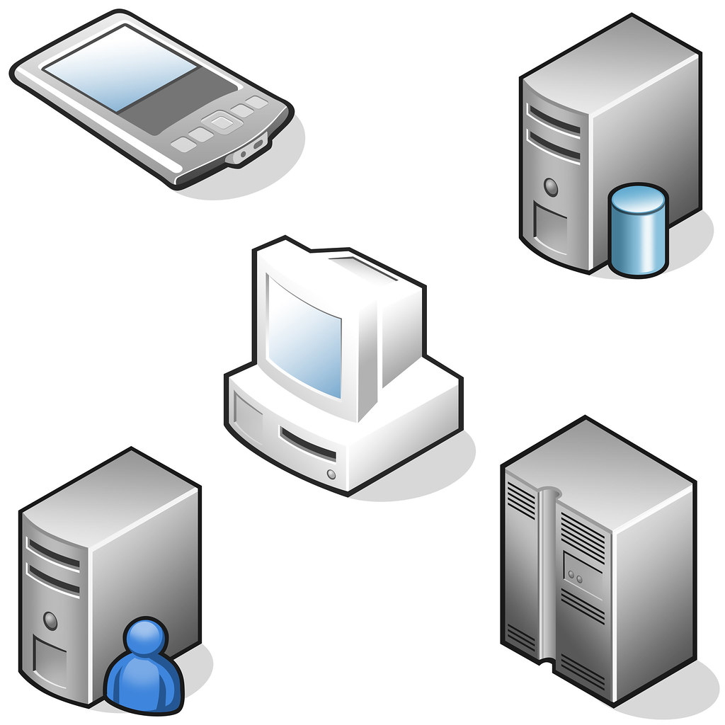

Consumer Driven Contracts
for Testing Services

Slide 2

Client Controller
Brokerage
Credit Authorization
Notes:
We have all tasted the Kool-Aid of Microservices, and we are hooked to varying degrees. Microservices split function and development into pieces, which are independently scalable according to their load
Also, you can leverage polyglot teams for development, so you can have Java, or Node, or whatever

Slide 3
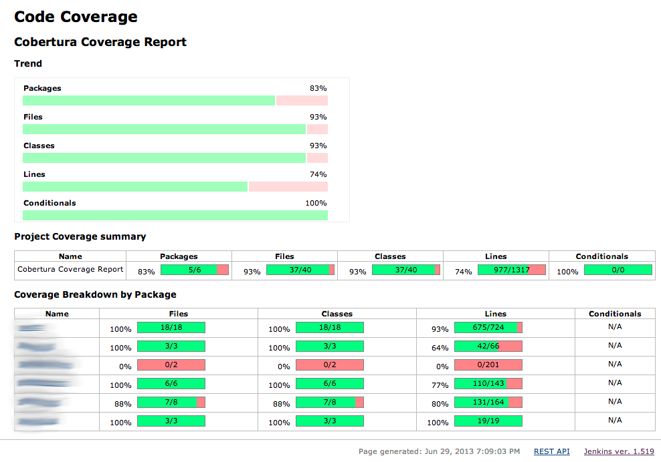
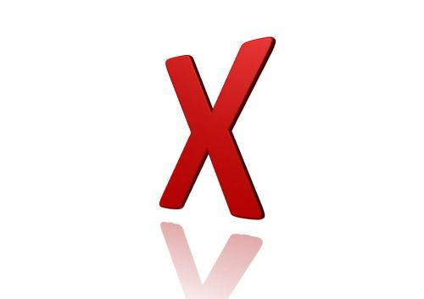


Challenges of Testing Services
You have high test coverage
All your service build tests are green
But what about the gateway endpoints? Do the services you call still support the endpoints you need?
How can you ensure all up & down stream dependencies are playing nicely?
One solution – Deploy all microservices, and test in real infrastructure.
But that requires infrastructure and team/version coordination
Notes:
You’ve built your 12 Factor microservices application, all tests pass with 95% coverage. Then you deploy to production, and kapow! Rollback!
What happened? – Well, your tests all passed but the consumers never tested their endpoints against the producer!

Slide 4
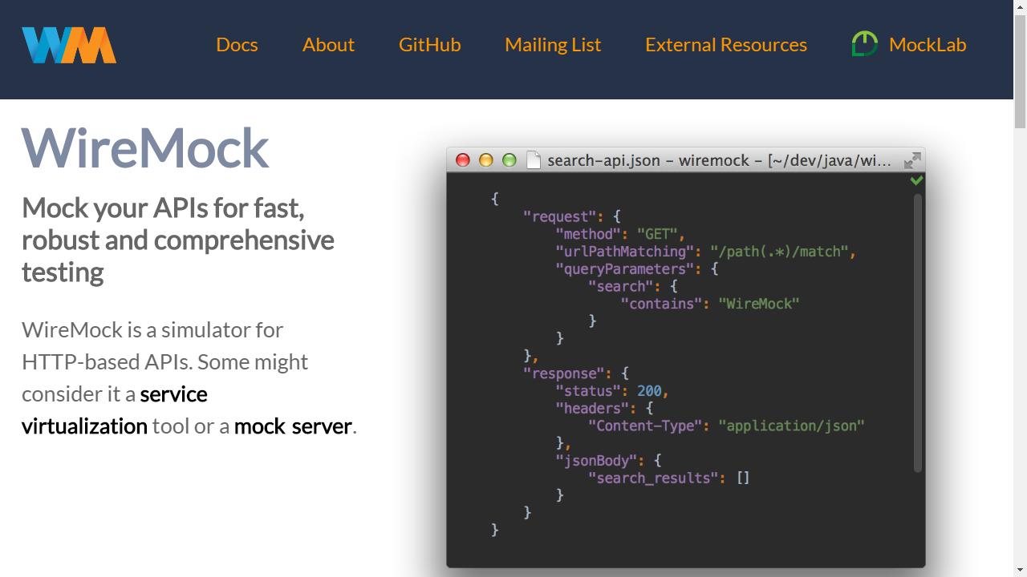
One possible solution…
WireMock lets you Mock your APIs for testing
WireMock simulates HTTP-based APIs.

Slide 5

Testing with Mocks
WireMockStub
Client Controller
Broker
Broker
Credit Line Increase

Slide 6
Client Stub
Requests regex map to consumer endpoints
{ "id" : "ae7f4f91-0e0e-45ba-8aa9-3d84bc8ccb12", "request" : { "url" : "/request-credit-increase", "method" : "POST", "headers" : { "Content-Type" : { "matches" : "application/json.*" } }, "bodyPatterns" : [ { "matchesJsonPath" : "$[?(@.['currentCreditLine'] =~ /-?(\\d*\\.\\d+)/)]" }, { "matchesJsonPath" : "$[?(@.['increaseAmount'] =~ /-?(\\d*\\.\\d+)/)]" }, { "matchesJsonPath" : "$[?(@.['clientId'] == 1)]" } ] }, "response" : { "status" : 200, "body" : "{\"date\":\"2019-08-14\",\"clientId\":{{{jsonPath request.body '$.clientId'}}} ,\"denialReason\":null,\"increaseAmount\":20000}", "headers" : { "Content-Type" : "application/json" }, "transformers" : [ "response-template" ] }, "uuid" : "ae7f4f91-0e0e-45ba-8aa9-3d84bc8ccb12" }

Slide 7

But who makes sure the ever-changing stubs remain in sync?

Slide 8

Contracts to the Rescue
A contract (aka “Pact”) gives the consumer the certainty that the stubs that you use were created by the service that you call.
If you can use them, it means that they were tested against the producer’s side. In short, you can trust those stubs.

Slide 9
Contracts
Defines all interactions between consumer and provider.
Includes request, response, protocol, headers, bodies, parameters …
Consumer
Regular expressions match contract request to stub endpoints.
Stub runner returns predefined responses in consumer tests.
Provider
Contract defines actual “Producer” values as inputs, and “Consumer” Regex for testing results.

Slide 10

Consumer Driven Contracts - Contracts Live in the Provider repo
Make this into an animation showing each step in squares
Workflow starts with Consumer:
Consumer’s job…
Notify Provider required change
Fork Provider repo
Change the contract – Consumer-side tests will break
Modify implementation, get tests to pass
Create Merge Request for Contracts in Provider repo
Provider now takes over:
Provider’s job…
Merge new contracts
Tests will fail
Adjust provider implementation to get it to pass
Commit changes
Generate Contracts
Deploy new version

Slide 11

Consumer Driven Contracts Workflow
TDD approach, where contracts are shared by consumers & providers
Consumer writes a (failing) test that exercises the call to the provider
Consumer forks a local copy of the provider project
Consumer defines contracts in the provider project, to generate stubs
Consumer creates a merge request to share the contract
Provider side automatically generates provider verification tests, which will fail, (since the functionality is not yet implemented)
Provider makes the tests pass by implementing the new functionality
By sharing contracts, we are guaranteed there will never be an impedance mismatch between the client and the provider
Provides current feedback, without setting up new infrastructure.

Slide 12
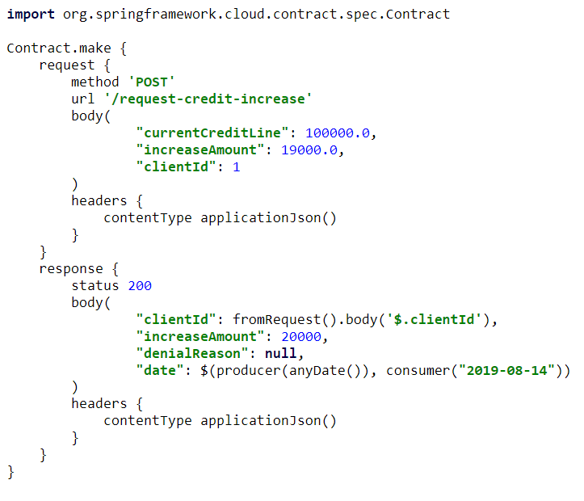
Spring Cloud Contract
Groovy-based DSL for defining shared contracts
On Consumer side, automatically generates stubs for consumer testing
Stub-runner plugin downloads and executes the provider APIs
On Provider side, automatically generates contract verification tests
Notes:
Explain that this step 1, the contract drives everything
The contracts reside in the provider side

Slide 13
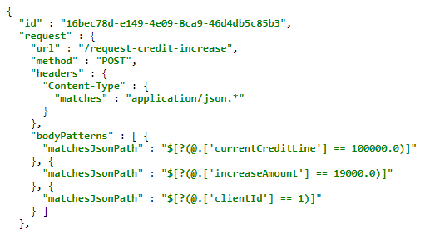
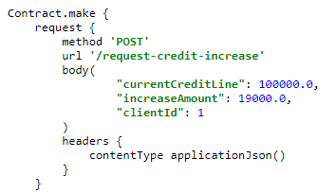

Slide 14
Provider Generated Test
@Test public void validate_shouldNotIncreaseCreditLimitIfNoAvailableCredit() throws Exception { // given: MockMvcRequestSpecification request = given() .header("Content-Type", "application/json")
.body("{\"currentCreditLine\":100000.0,\"increaseAmount\":1099000.0,\"clientId\":2}"); // when: ResponseOptions response = given().spec(request) .post("/request-credit-increase"); // then: assertThat(response.statusCode()).isEqualTo(200); assertThat(response.header("Content-Type")).matches("application/json.*"); // and: DocumentContext parsedJson = JsonPath.parse(response.getBody().asString()); assertThatJson(parsedJson).field("['increaseAmount']").isEqualTo(0); assertThatJson(parsedJson).field("['clientId']").isEqualTo(2); assertThatJson(parsedJson).field("['date']").matches("(\\d\\d\\d\\d)-(0[1-9]|1[012])-(0[1-9]|[12][0-9]|3[01])"); assertThatJson(parsedJson).field("['denialReason']").isEqualTo("Credit line has reached its max. Available: 900000.0"); }

Slide 15
Automated Tests
Both consumer and provider tests are executed against the same contract every time they run a build.
A breaking change on either side will automatically fail the build on the other side
Development is coordinated, in a TDD fashion…
Change consumer, break the build on the provider, fix the implementation on the provider, get the tests to pass

Slide 16

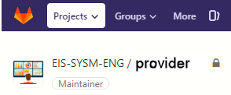


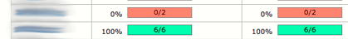
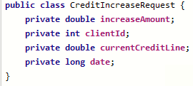
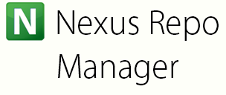
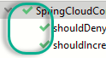
Consumer
Provider
1. Notify Provider change required
3. Change the contract
2. Fork Provider repo
8. Merge new contracts
7. Create Merge Request
9. Provider tests will fail
4. Consumer tests will break
5. Modify implementation
10. Modify implementation
6. Get tests to pass
11. Get tests to pass
12. Deploy Contracts
Notes:
Workflow starts with Consumer:
Consumer’s job…
Notify Provider required change
Fork Provider repo
Change the contract – Consumer-side tests will break
Modify implementation, get tests to pass
Create Merge Request for Contracts in Provider repo
Provider now takes over:
Provider’s job…
Merge new contracts
Tests will fail
Adjust provider implementation to get it to pass
Commit changes
Generate Contracts
Deploy new version

Slide 17

Stock Buy Sell Controller
Buy-Sell
Consumer
Credit Line Increase
Provider
Show a stock purchase
BuySellRequest
1,000 Shares IBM
CreditIncreaseRequest 2019-12-03 $100,000
BuySellResponse
Executed
CreditIncreaseResponse Approved

Slide 18
Goal – Change date format from String to Long
To start, we will see that all tests pass
Modify Consumer request and controller to use Long
Consumer tests unexpectedly still pass, because we are mocking
Introduce Maven dependencies in both providers and consumer
Add stub runner to Consumer test, remove mocks
Generate stubs
Consumer tests now fail
Correct contracts; generate new provider side stubs
Consumer tests should now pass
Provider tests should now fail
Fix provider impl
Provider tests should now pass

Slide 19
DEMO

Slide 20
Provider vs. Consumer-Driven Contracts
Provider Contracts – API producer maintains the contracts for all its consumers. Useful for:
Producers that cannot directly collaborate with their consumers - e.g. there are many consumers or they’re external
Consumer-Driven Contracts - Consumers play a vital role in the process of creating the contracts:
Easy to implement when both producer and consumer teams work for the same organizations
Number of consumers is not extremely large.

Slide 21

USEFUL LINKS
A step-by-step guide to Consumer Driven Contracts with Spring Cloud Contract: https://cloud.spring.io/spring-cloud-contract/
The three-second or three-minute tour give you a nice very brief walkthrough of Spring Cloud Contract.
Consumer Driven Contracts and Your Microservice Architecture by Marcin Grzejszczak (@mgrzejszczak) and Adib Saikali (@asaikali).
Implementation of the consumer driven contract library Pact for Javascript, from creating a test to generating the contract and uploading it to the Pact broker.
Spring Cloud Contract / Pact Integration: https://ordina-jworks.github.io/spring/2018/04/28/Spring-Cloud-Contract-meet-Pact.html
Code for this presentation: https://gitlab.nomura.com/vgrazi/consumer-driven-contracts

